Slide 1

isoKIT
A procedure based software platform to cover your business standards

Slide 2


isoKIT System
What is isoKIT
isoKIT is a software platform that provides modular definable/customizable sections with relational data sources and a workflow engine to cover information flows in your organization based on your requirement or any international standard (ISO).
isoKIT also includes a built-in form generator and report generator to facilitate workforce and provide insights in business layer.
With isoKIT you can easily create your very own version of a unified software platform to handle your systematic matters and put your efforts on other half of your business.
1
kitco.ir

Slide 3
isoKIT Implemenation
Simple implementation through pre-loaded wizards
Basics
Data
Flow
Control
Define basics
Stakeholders, roles, Permissions, currencies, languages, graphic themes and …
Define Data
Data types, data sets, data objects, data rules, data relations and Forms
Define Flows
Start to flow your forms and data based on roles, rules and permissions
Define Reports
Start to flow your forms and data based on roles, rules and permissions
Start to use and evaluate
2
kitco.ir

Slide 4
isoKIT Design Ideas
We built a system to cover different standards
Scope
Planning
Ability to choose the standard`s scope or even create a new one
Ability to define objectives, opportunities and risks and proper plans to achieve them
Normative references
Support
Ability to define legal and principle normative
Handling resources, competences, awareness, communications, and control documents
Terms
Operations
Define any terms and basic rules
Operational planning and control, overcome hazards, risks and manage changes
Context
Evaluation
Define organization needs and expectations
Monitoring and analyzing performance, competency, and internal audit program
Participation
Improvement
Create an era for leaders and workers to participate in roles and responsibilities
Continues development and handling incidents and corrective actions
3
kitco.ir

Slide 5
isoKIT Core Layers
Core layers which made the system working on most ISO standards
Reports
Fixed and customizable reports based on any standard`s requirements
Notifications
In-app, Email and SMS notifications
Form Engine
Customizable forms to overtake any standard`s requirements
Workflow Engine
Create multi step workflows to handle procedures in style
SQL Database Engine
Standard consequential database
4
kitco.ir

Slide 6
isoKIT Features
Features that can help your organization to achieve any international standard
Best Practice
Business Intelligence
Implicit best practices to reduce SDLC
Designed to academically use statistics to provide business insights
Design Standards
Web Platform
Easy modification of interface design based on your UI/UX expectation
Access to systems any time any where on any devices
Stakeholders
Implementation Speed
Core implementation of stakeholders, Users and permission control
Fast implementation through system wizards
5
kitco.ir

Slide 7



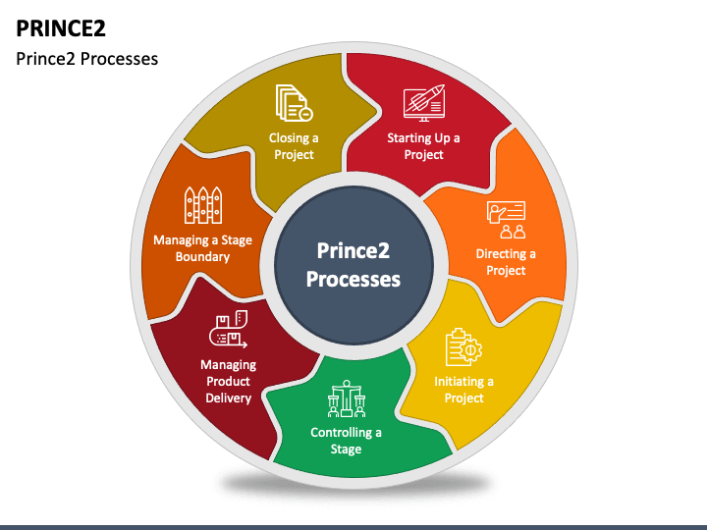
isoKIT Successes
Tested successfully in different standards
ISO 13485:2018
ISO: 45001:2016
PMBOK
PRINCE 2
6
kitco.ir

